Slide 1
Municipal Reference Model and Actionable Smarter Cities Messaging
Alison Oleksiak, Bob Dill,
Bruce Baron, Jim Amsden
November 30, 2010
Notes:
The MRM is primarily focused on municipal strategic planning: determining the organization units accountable for programs that administer services whose output results in outcomes that address the needs of target groups (MRM in a nutshell). The strategic planning exercise could use Focal Point to look at different projects that transition municipal programs and services to address different target group needs given budget constraints, resource limitations, time horizons, costs, etc.
The value of the integration between MRM and CBM would come from being able to connect municipal models to the CBM maps that guide the business transition strategy for IT solutions that support, automate, measure and/or assess the program services.
This requires a semantic mapping between MRM and CBM that involves the introduction of IT solutions in the scope of the committed projects. This focuses on the synergy between SA/MRM and CBM by using SA/MRM and Focal Point to identify the projects to fund (Do the Right Things), and then use parts of the MRM services, process and resource models with Actionable Business Architecture to drive out the IT solutions for those projects (Do Things Right).

Slide 2
IBM provides a wide range of offerings to support Smarter Cities
Business Challenge | Offering | Business Benefits
 | Smarter City Assessment
 | Smarter City Maturity Model

Slide 3
IBM provides a wide range of offerings to support Smarter Cities
Business Challenge | Offering | Business Benefits
 | Actionable Smarter Cities a engagement method whereby organizations can identify opportunities for improvement and innovation by regrouping their activities into a manageable number of discreet, modular, and re-usable components that enable flexibility and provide for a clarified focus on the core capabilities needed to realize business strategy
Move to a “whole of government” approach Seamless, citizen-centered services Legislation, regulations and policies designed rather than crafted Alignment, integration, interoperability, etc. in business systems Ability to do more with less | Municipal Reference Model A common language and structure for describing the business of Government that specifies a collection of reusable content and best practices that can be used to create and evolve specific municipal business architectures for strategic planning to help decide where to invest and when in order to maximize results | Interpret and clarify missions, strategies, outcomes, etc. Accurately depict how they work and how they can work together Discover opportunities for business improvements Support their planning and successful implementation A framework for assessment and continuous improvement

Slide 4
IBM Smarter Cities Data Comparison and Gap Analysis Offerings
City Forward - City Forward is a single destination where users can access aggregated, publicly available data about cities and metropolitan areas around the world, choosing from 100’s of attributes across 10 domains, from transportation to health to economics for comparison and assessment
Smarter City Assessment - where the city is compared with its peers, averages and aspirational targets across 7 areas (City Services, People, Business, Communication, Transport, Energy, Water), to determine opportunities for change
Smarter City Maturity Model – where the city’s maturity across 9 dimensions: City Governance & Strategy, Smarter Water, Smarter Transportation, Smarter Utilities, Smarter Safety and Emergency Management, Smarter Buildings, Smarter Health, Smarter Education, Smarter Business Partnerships to explore opportunities for change
Actionable Business Architecture for Smarter Cities which contains City Ecosystem model spanning 11 competencies and 185 components across strategy, planning & execution– By leveraging Outcome based business scenarios of “Understanding City Ecosystem” & “Making City Smarter”

Slide 5
Alignment with other initiatives
MISA Municipal Reference Model: Addresses the policy and planning domain for what the municipality does to evolves to address business influencers and meet community needs
Actionable Smarter Cities: A combination engagement method and platform for municipal strategic planning and operational support that combines some of the above. Based on CBMSOMA method and tools, feeding into WBM and SA based on GBS Actionable Business Architecture strategy. Addresses the operational domain for how the municipality provides the chosen programs and services in a smart, efficient way.
Physical Meets Digital-Physical Infrastructure (PMD-PI) for Smarter cities EA: This is essentially a technical architecture based on the Triton platform for collecting, analyzing, reporting and acting on real-time municipal information in support of municipal operations. Chris O'Connon
Cognos Performance Management Expert applied to Municipal Performance Management: Could be seen as component of the PMD-DI for bottom-up BI input into strategic planning driven by operational data.
Multi-Agent Accelerator, David Conh, creating a cloud based hub of services that can be composed into a relevant set of services.
Cause effect graph
Notes:
1. MISA Municipal Reference Model: This is a service-oriented Domain-Specific Language for defining municipal programs, services, processes and resource; and a reference model that uses this metamodel to define best practices and useful content as a starting point for municipal transition initiatives. It is essentially a reference model for a business architecture in the domain of municipal services. MRM would be used primarily for top-down strategic planning.
2. Physical Meets Digital-Physical Infrastructure (PMD-PI) for Smarter cities EA: This is essentially a technical architecture based on the Triton platform for collecting, analyzing, reporting and acting on real-time municipal information in support of municipal operations. Chris O'Connon
3. Cognos Performance Management Expert applied to Municipal Performance Management: Could be seen as component of the PMD-DI for bottom-up BI input into strategic planning driven by operational data.
4. Actionable Smarter Cities: A combination engagement method and platform for municipal strategic planning and operational support that combines some of the above. Based on CBMSOMA method and tools, feeding into WBM and SA based on GBS Actionable Business Architecture strategy. Essentially a method and supporting tools for a BPM-centric architectural style, technical architecture, and target platform. Also uses Cognos for BI.
5. Multi-Agent Accelerator, David Conh, creating a cloud based hub of services that can be composed into a relevant set of services.
6. Cause effect graph

Slide 6
Some GTM Ideas: Clear channels will help avoid confusion
Client Requirements
IBM Team
Model and Tool
Strategy, Transformation and Analytics Solutions
GBS S&T and BAO
ASC/CBM (*)
Cross-Selling Opportunities
Enterprise Architecture
GBS AIS
and Rational Services
MRM/RSA
(*) GBS would need to decide whether MISA content should be added for consulting and
solution spaces in S&T and BAO
Notes:
<jra>WBM, Compass, SOMA will have almost no leverage with customers doing municipal strategic planning. This just doesn’t address their primary concerns – target groups/outcomes (contrast with other businesses that are shareholder/profit motivated).
Rather these stakeholders may find MRM more compelling as it addresses their municipal business architecture at the constituent level, not at the IT solution level.
Then we follow up with ABA (and other approaches for enterprise and solution architecture, design, construction and deployment, operational platforms, business intelligence, etc.) to optimize how the municipality actually provides the services that are its target business architecture.</jra>

Slide 7
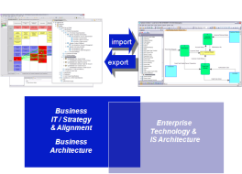
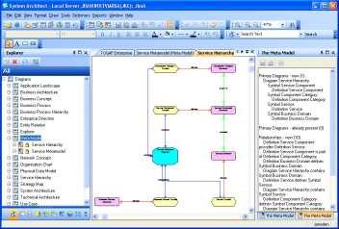
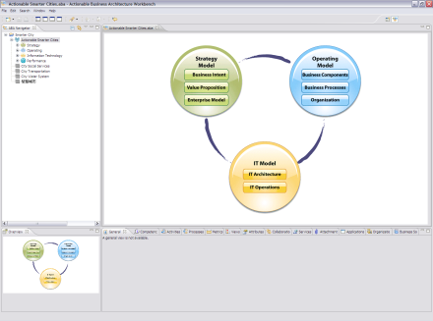
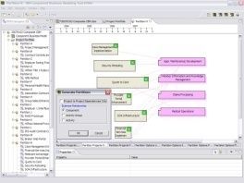
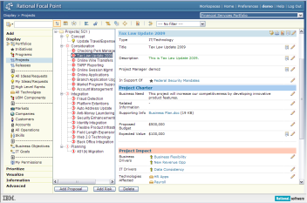
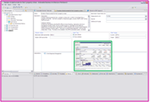
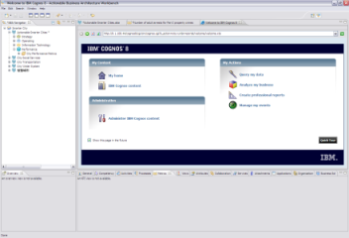
Initial Analysis on ASC-MRM Tooling Integration Interfaces can be established between ABA workbench and SWG products
ABA Workbench 1.0
(Client Value: Strategy and Transformation)
SWG Products
(Client Value: Ongoing Management)
CBM-SA Bridge v2
Rational System Architect
ABA User Interface
EPMH
(Enterprise Portfolio Management Hub)
Rational Focal Point
SWG Integration
Cognos Mashup Service
Cognos
Established Integration
Websphere Business Modeler
Lombardi Business Compass
SOME ME
Notes:
<jra>WBM, Compass, SOMA will have almost no leverage with customers doing municipal strategic planning. This just doesn’t address their primary concerns – target groups/outcomes (contrast with other businesses that are shareholder/profit motivated).
Rather these stakeholders may find MRM more compelling as it addresses their municipal business architecture at the constituent level, not at the IT solution level.
Then we follow up with ABA (and other approaches for enterprise and solution architecture, design, construction and deployment, operational platforms, business intelligence, etc.) to optimize how the municipality actually provides the services that are its target business architecture.</jra>

Slide 8
Integrated ASC – MRM – SCA/SCMM offering
Crawl: Positioning of current offerings
Shared taxonomy to translate various assessments into actionable next steps
SCA, SCMM, ASC and MRM capabilities defined, positioned and conceptually related
Result: MRM/ASC leveraging SCA for quicker baseline, and SCA issue areas have targeted areas for consideration
Walk: Information interchange between offerings
Basic Integration between data models for various offerings for KPIs to transfer and aggregate measurement
SCA alignment with SCMM, ASC and MRM content interchange
Result: SCA utilizes SCMM for assessment criteria analyzed with ASC which can reuse MRM content, MRM can use SCA and ASC as a means of planning transition initiatives
Run: Product integration
Full Integrations between data models for various offerings to transfer and aggregate content using seamless integration between stages or integration of team activities
SCA, ASC and MRM use shared information in single repository using a common (OSLC) resource model
Initial normalization of ASC and MRM content, better alignment between ASC assessment criteria, MRM performance indicators and SCMM domains and levels
Result: Integrated line-of-site from assessments of as-is municipal business architecture to strategic planning transition initiatives for to-be business architecture guided by proven government industry asset content and maturity models
Notes:
Crawl: at least some integration so its possible to move from one to another –in some progression or in case one doesn’t work out well. Conceptual, no actual exchange of data or integration.
Define the relationships and how we would use them
Walk: file interchange and converters
Run: product integration around OSLC MRM resource? For more complete integration.

Slide 9
CBM and MRM Conceptual Mapping
CBM Element | MRM Element | Notes
Business (CBM Map) | Organization Unit or Program (if there are many sub-programs) | Provides an overview of the accountabilities of an organization unit or sub-programs of a program
BusinessCompetency | Program | Organizations are accountable for programs that deliver outcomes that address target group needs. These are the competencies of the organization, and are a means of partitioning the accountabilities of an organization into logical, functional units.
AccountabilityLevel | Service | Provides a way of categorizing services for accountability purposes.
BusinessComponent | Service including Processes that implement the service | Programs administer services they are accountable for. These can be considered components of their competencies.
Attribute (for assessment evaluation criteria - KPI) | Performance Indicator | Programs, services, processes and resource can be assessed against performance indicators to determine their effectiveness. The target, planned and actual values for performance indicators can be mapped to CBM assessment criteria to create various heatmaps.
Notes:
CBM component describes the people, processes, information, services and technology that define a contribution to business performance in some competency
Heat maps support the assessment of component contribution to business performance
Different heap maps can be used to address different stakeholder concerns and can be overlaid to explore combined concerns
CBM map can be used to help understand the linkage between components to create a prioritized portfolio of business transformation initiatives – informed by hot items in the heat map
Link to SOMA helps eliminate the gaps between strategy and IT implementation
MRM Process Type has Delivering, Monitoring and Planning which corresponds closely to CBM Accountabilities – but doesn’t apply to MRM Service since services are intended to produce outputs that contributes to an outcome that address a target group’s needs. But maybe this could be adapted to broaden MRM to separate different aspects of services effecting different target groups (those responsible for planning and monitoring for example).

Slide 10
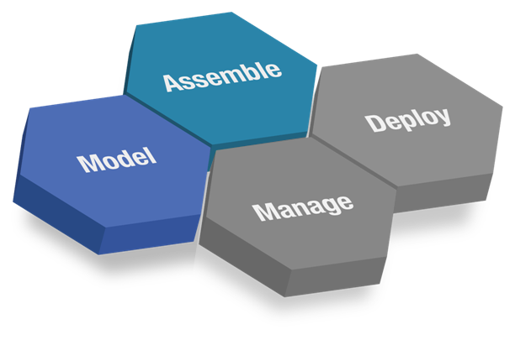
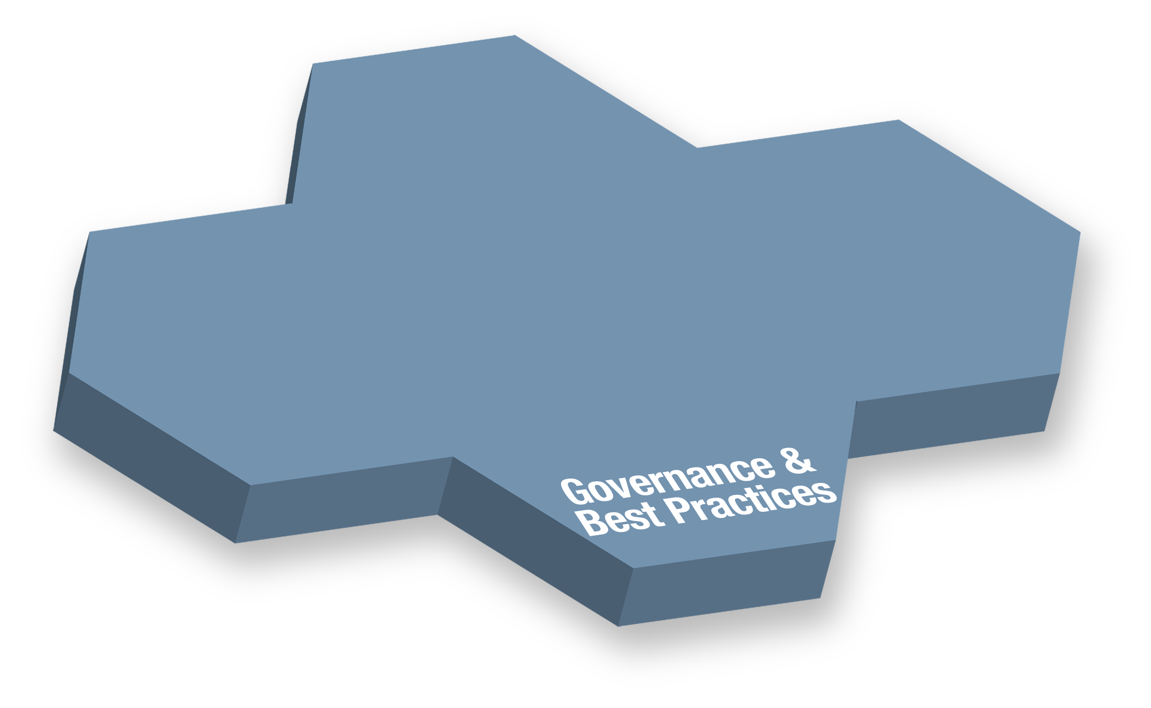
The Smarter Cities Lifecycle
Analyze and Design supporting IT solutions
Leverage industry assets
Actionable Smarter Cities
Standard middleware platforms
Physical Meets Digital
Enterprise Service Bus
Establish business vision and mission
Leverage Reference Models
Perform strategic planning
Align with applicable regulations
Business Intelligence
Financial Performance & Strategy Management
Advanced Analytics
Analytic applications for managing mission outcomes
Financial transparency
Business/IT alignment
Process control
Notes:
Modifying the SOA Lifecycle”
Model – Strategic Planning
Assemble – Solution Design and Construction
Deploy – Operational Platform
Manage – Business Analytics

Slide 11

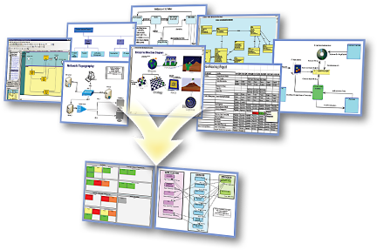
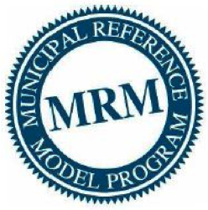
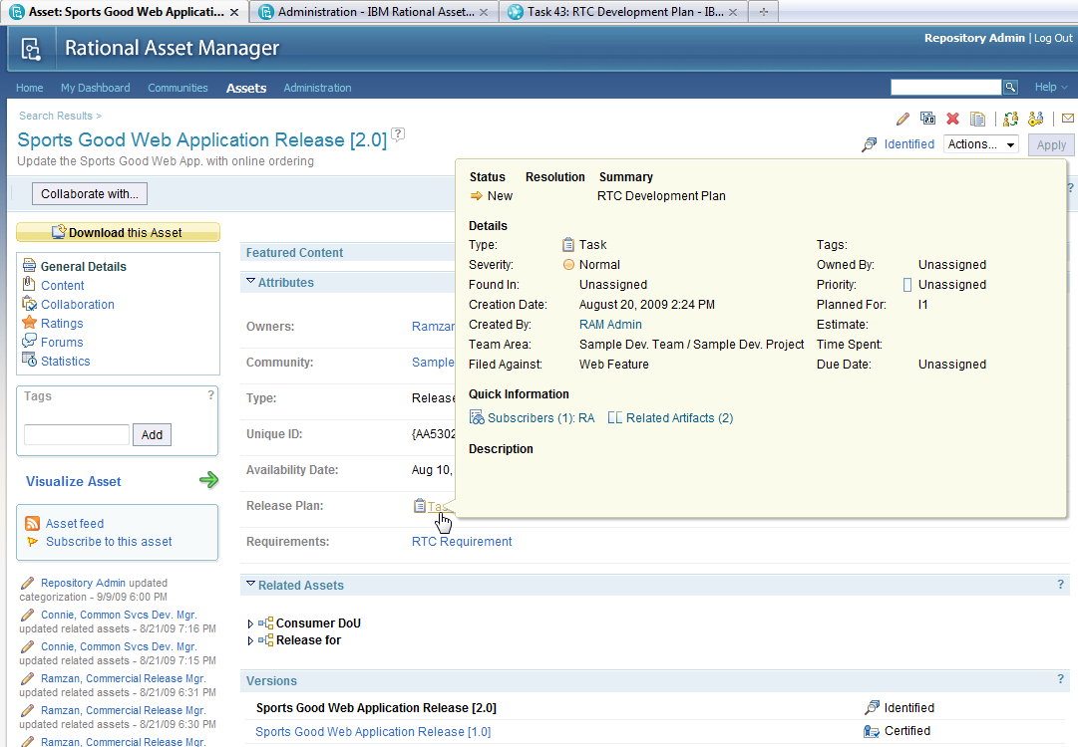
















Smarter Cities closes the loop on municipal planning, solution deployment, measures and metrics with business intelligence
Municipal Strategic Planning
Municipal Business Architecture
Project Portfolio Planning
Solution Design & Construction
Business Analytics
Asset Manager
Architect
Requirements Manager
Information Technology
Asset
Manager
Rational Software Architect
DOORS
Rational
Budgeting & Finance
Workforce/ HR
Mission Performance
Financial Performance
Jazz Platform
ClearQuest
ClearCase
Rational Team Concert
Requirements
Professional
Quality Manager
Executive Management
Operational Performance
Supply Chain
Operations/ Readiness
Program Execution
Services Delivery
Operational Platform
Cognos Blueprint
Smarter Cities Command and Control
Operations &
Planning
Situational Views
Simulation &
Investigation
Incident Mgmt
Trends & Analysis
Cross-domain
collaboration
WebSphere Process Server
Physical Meets Digital
Live Feeds
(Sensors & Subsystems)
Actionable Smarter Cities
Triton
Team Solution Design
Notes:
Business Analytics for Municipal Government
Provides an effective means of analyzing operational information to enable effective management within the current global financial and economic environment to lay a foundation to build a better future
Enables collaboration within and across governments and target communities for policy development, planning, execution and management
Physical Meets Digital supports Smarter Cities Command and Control to automate and manage public service sub-systems using a collaborative environment that enables a city’s core systems to become smarter:
Collect, Filter and Manage the Right Kind of Data
Integrate, Analyze and Operationalize the Data
Optimize Citywide Systems to Achieve Desired Behavior
The Triton Platform can accelerate time-to-value for municipal IT solutions
What it is: “Triton” is a SWG asset from IBM providing an accelerated delivery of a SOA Foundation Infrastructure utilizing IBM Intellectual Property Assets including the Installation, Configuration and applicable implementation assets necessary to provide a fully functional SOA Foundation
What it does: Enable delivery excellence in delivering a SOA infrastructure by leveraging SOA Implementation Requirements, best practices, documentation, scripts, effectively utilizing harvested implementation assets
Why use it: To accelerate implementations (calendar and overall person/year effort) and lower risk, and leverage SOA best practices from across IBM globally.
Goal: Delivery of SOA Infrastructure Functionality (as Working Vehicle) vs, SOA “Do it yourself Kit” (Pile of Vehicle Parts & Assembly Instructions & Project Plan & Crossed Fingers & No assurance it will meet functional requirements and be delivered on time/on budget….if ever.)

Slide 12
Objectives - Coherent Government by design
If we really want:
to move to a “whole of government” approach,
seamless, citizen-centred services,
legislation, regulations and policies designed rather than crafted,
alignment, integration, interoperability, etc. in our business systems,
to do more with less
We really need:
a consistent and more formal business design capability based on a common language and set of rules for using it to create better descriptions of what we want (e.g. more coherent ones). A pan-Canadian standard along these lines will enable any conceivable government line-of-business (and inter-collaborations thereof) to better:
interpret and clarify their missions, strategies, outcomes, etc.
accurately depict or map how they work (and how they can work together),
discover opportunities for business improvements,
support their planning and successful implementation.

Slide 13
The Municipal Reference Model Version 2 (MRM v2)
MRM v2 Goal: to create a Tool (Product, Service) that will help municipal governments describe their vision, goals, objectives, programs, services and performance metrics.
…in a standard way
…using precise definitions and concepts accepted and adopted by all governments in Canada
…with tools and templates to help you create the descriptions of the municipality
…with user guides and training material to help create and use these descriptions for a range of municipal purposes
…with a repository where these descriptions can be saved
…repository pre-populated with a generic set of service descriptions that may be provided to any municipality in Canada
…repository pre-populated with specific descriptions (models) created by other municipalities
…with tools that allow for the analysis and comparison of such descriptions
…and with a collaboration space that allows ideas to be shared on how these tools are being used in participating municipalities
In short: A powerful Authoritative Service Catalogue aligned to an Authoritative Meta Model that all Municipalities can use and share.

Slide 14
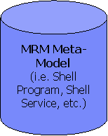
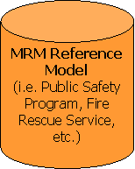
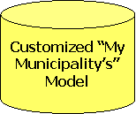
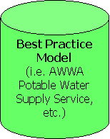
Revised target MISA Delivery Platform Governance and Operations
Governance (MRM and Delivery Platform)
Subscriber (Municipalities) Lifecycle Management
Collaboration
Workspace
Design & Modeling Tool Provision
(Image & License Mngt)
Search, Query, Reporting, Import & Export Capabilities
Application & Infrastructure Delivery Platform & Operations (eSolutions)
Municipality Platform Governance and Operations
My Municipality Model Management
Administration
Project
Support
Arch & Model
Review Board
Meta
Modeler
Reference
Modeler
Strategy & Planning
IT Architecture
& Design
Business Operations
Organization &
Process Optimization
Strategic
Intent & Priority
Business
Architecture
Enterprise
Architecture
Executive
Dashboard
BI & Analytics
Organization
Modeling
Application/
Service
Architecture
Technical
Architecture
Solution
Architectures
Mission
Performance
Financial
Performance
Process
Modeling
Transition &
Roadmap
Build &
Test
Operational
Performance
Process
Simulation
Municipality Collaboration, Design & Content Mngt Platforms

Slide 15
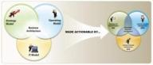
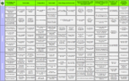

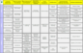
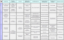
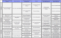
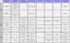
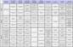
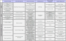
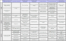
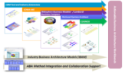
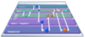


Built upon the strengths of CBM and ABA, Actionable Smarter Cities represents an integrated approach to planning and managing a city’s transformation journey
CBM: Component Business Modeling; ABA: Actionable Business Architecture
Overall Approach
Key Assets
The models include:
Descriptions, Activities, Metrics, Organizations, Collaborations, etc.
Business Scenarios, Views & Heat Maps
Actionable Smarter Cities
drives downstream transformation from Strategy to Operations and Technology
Component Business Models
City Ecosystem
… incorporates proven methods, models, metrics and tools, e.g. CBM, BPM, SOMA, EPM, BVM, etc.
Transportation
Water
Social Services
Local Government
Other Core Systems
Public Safety
Citizen Health
Energy
Environment
Urban planning
Economic Development
Education
Culture and Recreation
Judicial and Justice
etc.
…
Business of IT
Finance
Payment
Human Capital
Other Shared Services
Procurement
Asset Management
Tax Collection
etc.
… integrates relevant tools across IBM
…
Process Models
IT Services, Information & Infrastructure
IBM Solutions and Project Portfolio

Slide 16
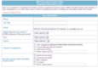
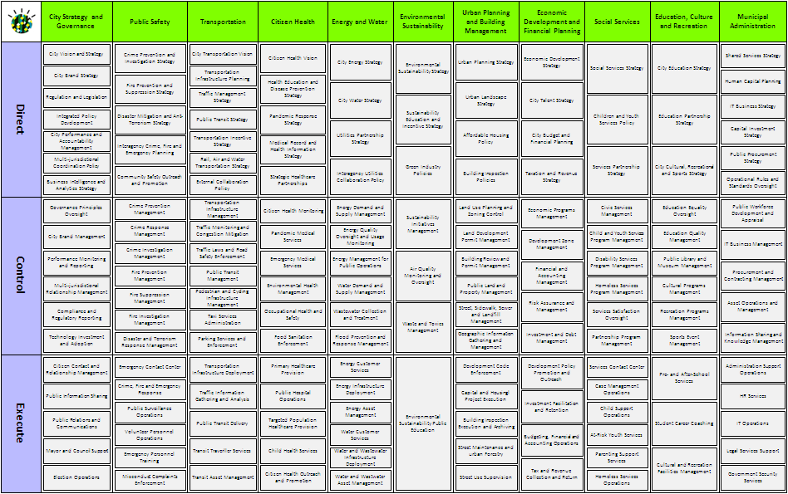
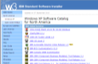
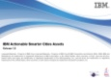
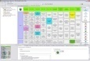
Actionable Smarter Cities Release 1.0 includes four deliverables; they are packaged into the CBM Tool and can be installed from ISSI worldwide
Deliverables in Release 1.0 …
… are embedded in the CBM Tool
I. City Ecosystem Model
II. Competency Descriptions
User registration
http://9.9.149.16:8080/ASC/
ISSI installation
Tool launch
User Interface
III. Component Descriptions
IV. Business-Critical Content Illustrations

Slide 17
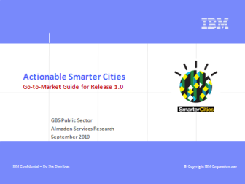
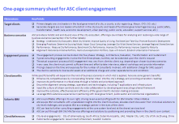
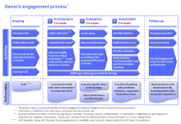
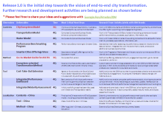
To facilitate field adoption, a comprehensive Go-to-Market Guide was prepared
Value Propositions
Engagement Process
Outline
Asset Introduction
Client Engagement
Business Scenarios
Client References
Research Roadmap
Appendices
Content Illustrations
Component Business Modeling (CBM)
Actionable Business Architecture (ABA)
Research Roadmap
http://w3.ibm.com/connections/wikis/home?lang=en#/wiki/ActionableSmarterCities/page/Go-To-Market%20Guide

Slide 18
Outcome-driven business scenarios were specified to indicate how ASC assets can be used to create value by addressing specific client challenges
Strategy
Emerging Practices
Understand City Ecosystem
Make City Smarter
Improve Quality of Living
Facilitate Cost-Take-Out
Promote Economic Development
Determine Sourcing Model
Adopt Cloud Computing
Leverage City-Wide Shared Services
Leverage Regional Shared Services
Performance
Alignment
Measure City Performance
Benchmark City Performance
Improve City Performance
Improve Capability Maturity
Rationalize Initiative Portfolio
Restructure Application Portfolio
Cope with Growth
Establish Urbanization Framework
Notes:
The choice of business scenarios varies from city to city, from country to country, and even from time to time, depending on the extent of urbanization of the city and its particular needs and preferences thanks to social and economic factors.
Multiple business scenarios can be bundled into a single engagement (e.g. Make City Smarter & Determine Sourcing Model).
The above list is for illustration purpose; it is by no means exhaustive. Suggestions for new scenarios are most welcome.

Slide 19





Example: Make City Smarter (with IBM Solutions)
Narratives from city leadership
We like IBM’s Smarter Cities propositions and would like to take them forward in our city.
Which areas in the city should we focus on to make them smarter?
What level of smartness is our city in these areas?
Where does our city stand in comparison to our desired level and/or the level of other cities?
How can we address the gaps? How can IBM solutions help? How does the transition roadmap look like?
Engagement Steps | Deliverables | Notes
Customize the ASC template to the client’s own situation and preference, including component names and descriptions. | Customized City Model | ASC template Client interviews and workshops
Create a View based on the city model to classify the components according to their relevance to Smarter Cities propositions (e.g. 3 categories: critical, important, nice-to-have) | Smartness Relevance View | Smarter Cities propositions are based on the 3Is: instrumented, interconnected, intelligent
Assess each component’s as-is level of smartness, agree on its to-be level of smartness (e.g. based on client’s own targets, IBM’s recommendation, or city benchmarks), and thus identify the gap for improvement | Smartness Level Views (as-is & to-be) | Create two views, one for as-is assessment and the other for to-be assessment, using scale such as 1-5 or L-M-H
Create a Heat Map by combining the relevance view and the level views, helping the client choose the components that require most attention (e.g. critical & big gap) | Smartness Heat Map | Use the Heat Map function in the ASC tool
Identify potential project initiatives that can be used to address the smartness gaps in the chosen components and conduct high-level analysis of the initiatives (e.g. feasibility, ROI, etc.) | Potential Project Initiatives | The identification process needs to be impartial, though the initiative list should include IBM solutions
Prioritize and plan the initiatives into a transition roadmap that takes the city from the current to the desired level of smartness | Transition Roadmap | The timing of the initiatives is planned to exert maximum impact
* This scenario needs to be refined and developed through actual client engagements.
Notes:
The client is receptive to the idea of “Smarter Cities” put forward by IBM and would like to define what it really means to their strategy and how they can align performance, capabilities, initiatives and IT applications across the city
The client is interested in the principles of “Smarter Cities”, but does not know where to start and how to plan their own journey
The client views and manages its businesses based on organizational chart and departmental charters, which concentrate on internal aspects of the municipal government and tend to neglect critical issues that are outside its authority

Slide 20
What is “Triton”
Page instructions – insert a bullet-point-list of the “elevator pitch” / “2-minute message”:
What it is: “Triton” is a SWG asset from IBM providing an accelerated delivery of a SOA Foundation Infrastructure utilizing IBM Intellectual Property Assets including the Installation, Configuration and applicable implementation assets necessary to provide a fully functional SOA Foundation
What it does: Enable delivery excellence in delivering a SOA infrastructure by leveraging SOA Implementation Requirements, best practices, documentation, scripts, effectively utilizing harvested implementation assets
Why use it: To accelerate implementations (calendar and overall person/year effort) and lower risk, and leverage SOA best practices from across IBM globally.
Goal: Delivery of SOA Infrastructure Functionality (as Working Vehicle) vs, SOA “Do it yourself Kit” (Pile of Vehicle Parts & Assembly Instructions & Project Plan & Crossed Fingers & No assurance it will meet functional requirements and be delivered on time/on budget….if ever.)
Remember: It’s not Industry Specific!

Slide 21
Integrated Solution Domains in Government Powered by the IBM Frameworks for Government
Government Industry Domains
Defense/NCO Domains
Systems Integrator and Partner Solution Content
Tax and Revenue Management
Safety and Security
Social Services and Social Security
Integrated Urban Infrastructure
Metropolitan Transportation and Roads
Defense
Intelligence
Command and Control
Logistics
IBM Frameworks for Government
Partner Enablement & Validation Program
SWG
Extensions
Government Specific Extensions
NCO Specific Extensions
Common Government Industry Extensions
Government Framework Software Foundation “Triton”
Common Technologies and Architecture
Infrastructure
21
Notes:
A closer look at the IBM Frameworks for government. You can see the business domains addressed. Notice the domains previously covered by the CBRM solutions. You will also notice the “new” domains, such as Integrated Urban Infrastructure (supporting smarter cities), social services and Municipal Transportation and Roads as well as the domains that fall under defense.
You may be thinking that most of these domains seem to be unrelated – in many cases they are unrelated, but there are relationships across these “silos” of government, as an example, security is related to revenue management. Think about how money laundering is addressed not only by treasury but also law enforcement. Think about how intelligent transport systems are involved in emergency and disaster management which is within the safety domain. Many social services programs are offered by smart cities via self service kiosks or online. Think interconnected, instrumented and intelligent…
To help our government customers become Interconnected, Instrumented and connected, SWG is leveraging common technologies across all of the government domains with the Triton Core SOA foundation and Single View, while specializing with extensions specific to a particular domain.
The third tenant of the IBM Framework strategy is he Business partner enablement and validation program. IBM has invested in a dedicated program to attract and enable top notch business partners that develop business applications that are validated on the framework platform.
21

Slide 22
Triton - Core Functionality Module
Notes:
The purpose of this slide is to help illustrate how you apply real software to the SOA Core Services, While each industry may have slightly different names for the functional areas i..e. collaboration, discovery, Enterprise Service management…. The important thing is that they are in there, no matter how you re-arrange the diagram. To have true SOA value, you need more than a pile of software. Think of me dumping a load of lumber and supplies on an empty lot. That does not equate to a house you can live in. What we have done with “Triton” is take that lumber, apply the skills and services necessary to transform those “parts” into useful “functions”.

Slide 23
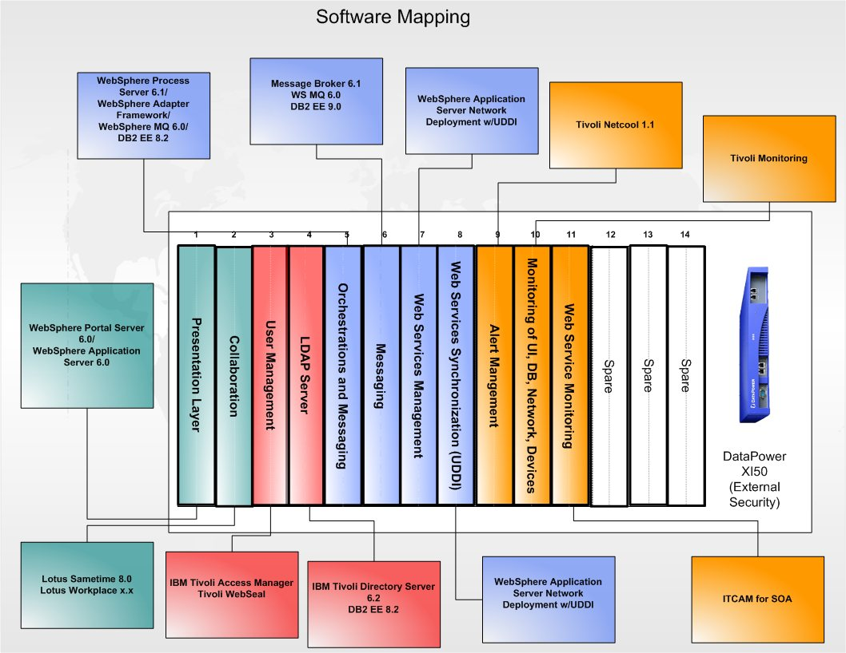
Functional/Software Mapping

Slide 24
Triton - Capability Modules
Core Foundation – Identity, Presentation Layer , Application Server, ESB, Web Service Registry
Additional Capability Modules
Mobile Deployment
Content Management
File Management
Process Modeling & Management
Cyber Security
Extract Transfer & Load
Business Rules Management
Integrated Architecture Modeling & Management
Enterprise Service Management
Collaboration

Slide 25
Triton Assets
Pre-Sales/Marketing
Proposal / Response
Delivery
Sales Cheat Sheet
Internal Enablement
Virtual Summit (Recordings)
External Presentations
Access to WW Team for Direct Customer Sales Support
Worldwide Live Demonstration Sites (See: Triton Universe)
Pre-Written RFI Input
SWG Bill of Materials (Part Numbers/Value Units with Pricing)
Pre-Installed/Pre-Configured VMWare Images
Method WorkProducts
Requirements
Architecture
Use Case / UML Model
Security Posture / Hardening
Installation/Configuration Scripts
Triton IBM SWG Products (Currently Red Hat Linux Versions)
Sample Integration Applications
Testing
Installation/Product Validation
Integration
Load/Stress/Performance
Implementation Guidance
High Availability / Resilience
SOA Federation
All Assets are available to all IBM employees via wiki at
https://w3.tap.ibm.com/w3ki08/display/FWKS/Framework+Foundation+Triton-Core

Slide 26
Review of Typical Provisioning Options
1. Accelerator
“The Cook Book”
Delivery: Skilled Delivery Teams use components as they see fit
Architecture Assets
Design Assets
Code Assets
Tools Assets
2. Soft Appliance
“Operational Software Images”
Delivery: Framework Factories ship completed images
Complete Installation, Virtualized Environment (Software Images)
No Hardware Provided
Architecture Assets
Available Today for Intel/“x” , “z” images currently being built
3. Hard Appliance
“Operational Software PLUS Hardware”
Delivery: A complete working SOA Infrastructure – Just plug it in.
Can leverage hardware virtualization or “native build”
Available today on Intel “x” platform.
All documentation & assets provided
Use whatever assets are of value to you and your delivery team
Deliver SOA Functionality “In a Box”.
Get a “Quick Start” on delivering mission/business value
26
Notes:
26

Slide 27
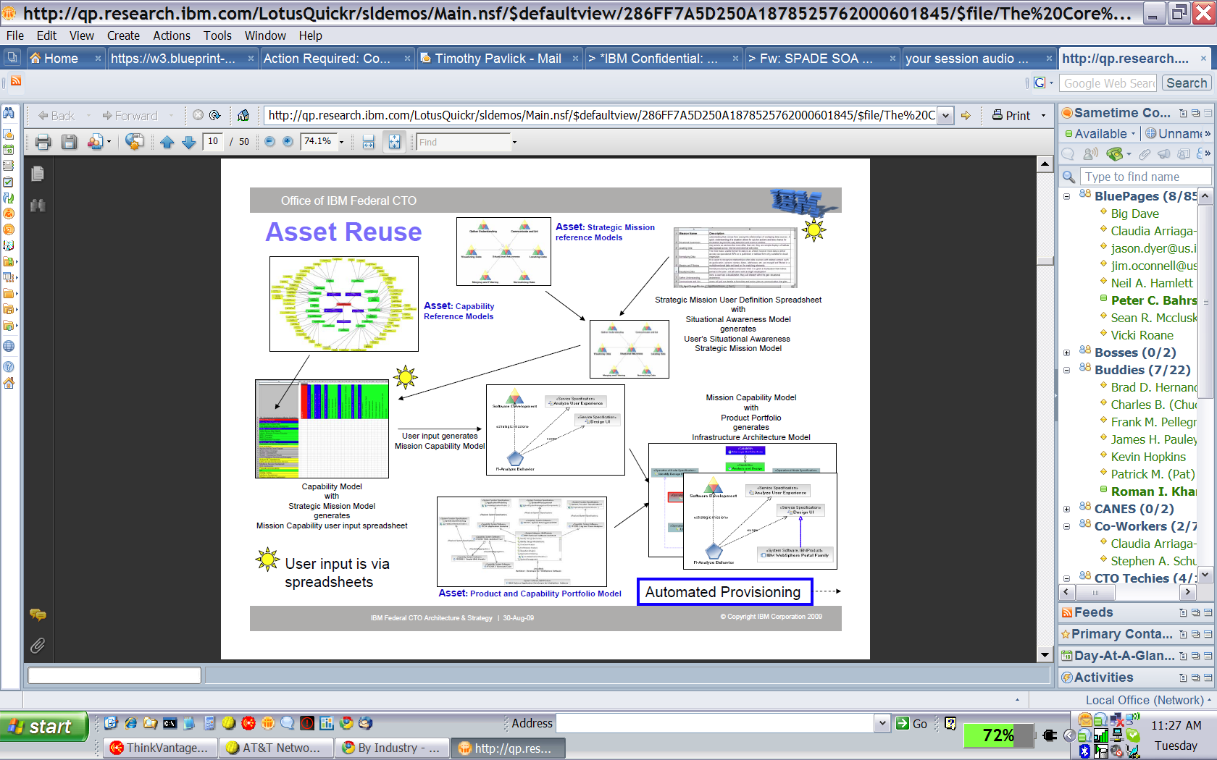
Triton Development Tools
Run Time
Development Tools
Business Requirements
Business Model
Use Case(s)
IT Capabilities Model
Triton Run Time Capabilities
Pattern
27
Notes:
IBM Confidential

Slide 28
Physical Infrastructure Vision for Smarter Cities
Smarter Cities Command and Control
Smarter Cities Subsystems
Citywide Situational Awareness
Tactical and Operational Control of City Infrastructure Subsystems
Events
Alerts
Incidents
Response
Aggregated data from subsystems for citywide operations, planning, & collaboration
Common operational view
Cross-City situational awareness, status, and control (incident management)
Trend and analysis prediction
Simulation and investigation
Process optimization
Sensor based data collection
Legacy integration
Correlation and filtering
Real-time & predictive analytics
Automated actions
Incident collaboration
Automate and manage public service sub-systems to create a collaborative environment that enables a city’s core systems to become smarter:
Collect, Filter and Manage the Right Kind of Data
Integrate, Analyze and Operationalize the Data
Optimize Citywide Systems to Achieve Desired Behavior
Notes:
PI – Physical Infrastructure
PMD – Physical Meets Digital

Slide 29
Smarter Cities Situational Awareness Dashboard: Top Line Functional View
Hosted
Operations &
Planning
Role Based
Situational Views
Personalization
Incident Mgmt
Customization
Security
Trends & Analysis
Navigation
Simulation &
Investigation
Single Sign On
Live Feeds
(Sensors & Subsystems)
Cross-domain
collaboration
Vertical Integration: Subsystem to Citywide Command
Horizontal Integration: Citywide Command to Citywide Command
Notes:
29

Slide 30
Proposed Physical Infrastructure Portfolio
Primary
Assets
Products
Delivered Business Value
Smarter Government Public Safety
Intelligent Video Surveillance Optimization & Analytics
Public Safety Crime Information Warehouse & Predictive Analytics
Public Safety Crime Prediction & Prevention
Public Safety Asset Predictive Diagnostics & Analytics (assumes Infrastructure/network monitoring)
Emergency Mgmt and Virtual Ops Center
SSE, MILS (GTS), Maximo, Cognos, ILog
IIC
Intelligent Traffic Prediction & Analytics (includes Expansion Analytics)
Transportation Bus Arrival Prediction
Transportation Integrated Fare Management
Transportation Asset Predictive Diagnostics & Analytics
Transportation Congestion Pricing
Transportation Route Guidance
TPT, DEA, Bus Arrival -
ADAM (rail) (Research) Maximo, IIC
Smarter Transportation
Water Management Asset Predictive Diagnostics & Analytics
Water Management Field Service Optimization
Water Management Rate Structure Analytics
Water Management Non-Revenue Water Analytics
Natural Water Management
Waste and Storm Water Management
Integrated Smart Water Utility
ADAM, SCWA assets, Maximo NetCool Cognos
SPSS, IIC
Smarter Water Management
Smarter Cities
Smart Cities Kit
Situational Command and Control Dashboard
DOP,
Smarter Buildings
Buildings Management Energy and Asset Optimization
Buildings Management Energy Performance Analytics
Buildings Management Asset Predictive Diagnostics & Analytics
Tenant Chargeback Management
Usage Based Pricing
Netcool Maximo Mashup Center, Green Sigma, ADAM, Access Mgr, ITMfEM, IIC, PPMS
Smart Grid
Grid Management Asset Predictive Diagnostics & Analytics
Grid Management Field Service Optimization
Grid Management Network Performance & Security
ADAM, Maximo, Netcool, Cognos, ILOG, FileNet, IIC

Slide 31
Family Plan Positioning
Top 10 Competitive Strengths
Top 3-5 Marketplace Opportunities
Smarter Public Safety:
Large reference installation, City of Chicago OEMC, NYPD
Rapid access video search and compound query capabilities
Applicable to airports, train stations and seaports to aid in detecting abandoned objects, intrusion prevention, facial recognition, and behavioral analysis
Smarter Metropolitan & Highway Transportation:
Highly accurate prediction capability (patent pending technology)
Engineered for metropolitan areas
Traffic flow simulation when sensor data is limited
Smarter Water & Grid Management:
Delivers insight and decision making capability through analytics and alerting
Reduces reactive maintenance
Improves field service operations
Smarter Buildings Management:
IBM has a facilities Management marketplace position
Integrated real time facilities energy and buildings management
Global alliance with BAS vendor JCI, and partnerships with Siemens and Schneider
Improve video monitoring and surveillance to reduce crime, improve compliance - Addressed
Reduce Traffic Congestion – Addressed
Improve Building Energy Efficiency – Addressed
Improve asset availability and maintenance operation - Addressed
Top 5 Customer Needs
View and monitor activities to prevent crime and even predict possible events by recognizing and analyzing certain patterns and data in real time.
Improved traffic prediction and reduced congestion to improve usage of existing roadways.
Improved utility service reliability and reduce service operation reactive maintenance.
Reduced utilities maintenance operational expense
Improved asset management and reduced energy consumption in buildings.
Notes:
PURPOSE: Summarize the existing positioning of the product in the market and highlight enhancements planned to each category via this new offering
SOURCE: Product Marketing, Sales, Development, Release Management; Project Planning Document and Requirements
Competitive Strengths – Describe the top 10 strengths of the offering. (The ‘weapons’ used against competitors.)
Include the following information for each strength:
Feature/Feature Set name (e.g. Data compression)
Business value to the customer, including metrics (Reduce storage costs by 50%.)
Customer Name and customer proof point
Marketplace Opportunities – Describe the top 3-5 opportunities to address existing marketplace needs.
Include how/if this offering is addressing those.
Customer Needs – Describe the top 3-5 customer needs/painpoints for this offering.
Should focus on quality, consumability, performance, integration, etc.
Include how/if this offering is addressing those.

Slide 32
Measurement & Reporting capability supports flexibility for municipalities to leverage their own design tools
1
Business Intelligence
2
Financial Performance & Strategy Management
3
Advanced Analytics
4
Analytic Applications
Monitoring & measuring mission performance to ensure the best outcomes.
Financial and operational performance tied to attaining mission objectives.
Predictive models, forecasting & “what-if” scenarios for refining finance and operations to deliver mission objectives.
Analytic applications developed for specific functions to better manage mission outcomes.
Supply Chain Analytics
Workforce Analytics
Financial Performance Analytics
Planning
What-If Scenarios
Forecasting
Predictive Analytics
Financial Reporting
Financial Analysis
Operational & Financial Risk Management
Scorecards
Reporting
Analysis
Senior Executive Level, Managers
Office of Finance, Program Offices
Office of Finance, Program Offices, Administration
Specific Roles (HR, Supply Chain, Finance, Logistics)
Moves beyond Sense & Respond to Predict & Act…at the time and point of impact!
Notes:
MPM – Municipal Performance Management
IBM Business Analytics helps governments manage these three critical components of mission, financial and operational performance and drive the best possible outcomes by offering strong solutions that help government leaders manage the day-to-day and long-term activities that ensure they deliver the best possible government. From business intelligence solutions such as scorecards, reports and analysis to strategy management through executive level dashboards with planning capabilities built in to advanced analytics that employ predictive modeling and what-if scaenarieos to help government leaders understand the short and long-term impacts of their decisions.

Slide 33
ITR validated the requirement to be able to measure and report performance at the functional level using the MRM V2 model and operational data
Information Technology
Budgeting & Finance
Workforce/ HR
Mission Performance
Financial Performance
Operational Performance
Executive Management
Supply Chain
Operations/ Readiness
Services Delivery
Program Execution
Notes:
33

Slide 34


ITR recommendation: Should leverage tools targeted to support measurement & reporting capability instead of developing scripts
1
Business Intelligence
2
Financial Performance & Strategy Management
3
Advanced Analytics
4
Analytic Applications
Monitoring & measuring mission performance to ensure the best outcomes.
Financial and operational performance tied to attaining mission objectives.
Predictive models, forecasting & “what-if” scenarios for refining finance and operations to deliver mission objectives.
Analytic applications developed for specific functions to better manage mission outcomes.
Municipal Executive Dashboard
CFO Dashboard for Government
Municipal Performance Scorecard
Rational
Focal Point/Insight
Rational
Focal Point/Insight
Analytic Applications for Government
Senior Executive Level, Managers
Office of Finance, Program Offices
Office of Finance, Program Offices, Administration
Specific Roles (HR, Supply Chain, Finance, Logistics)
Note – Rational Insight, Rational FocalPoint and Cognos already integrated with Rational tools. Request to investigate whether other BI/Dashboard/Analytics tools integrated (e.g. BusinessObjects)

